Slide 1
Dumbways Bootcamp Devops
Final Task
Gilbran Fairuz Maulana

Slide 2
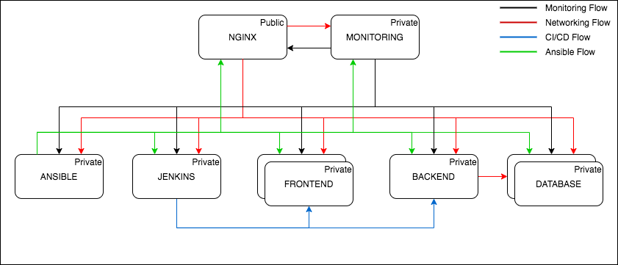
Design Infrstructure

Slide 3
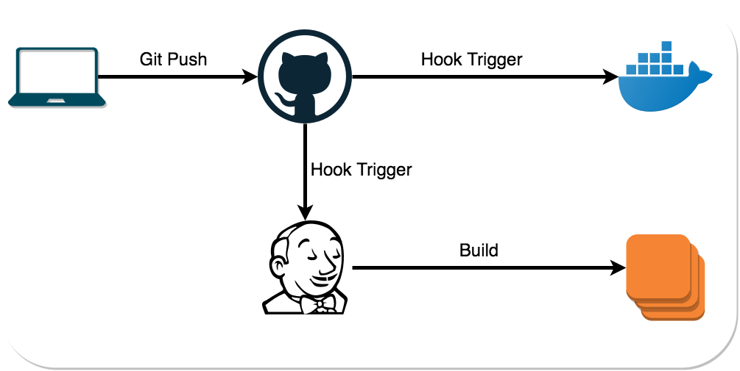
Flow CI/CD

Slide 4
Final Task
Repository
Server
User
SSH
Database
Web Server
Deployment
CI/CD
Monitoring
Authetication

Slide 5
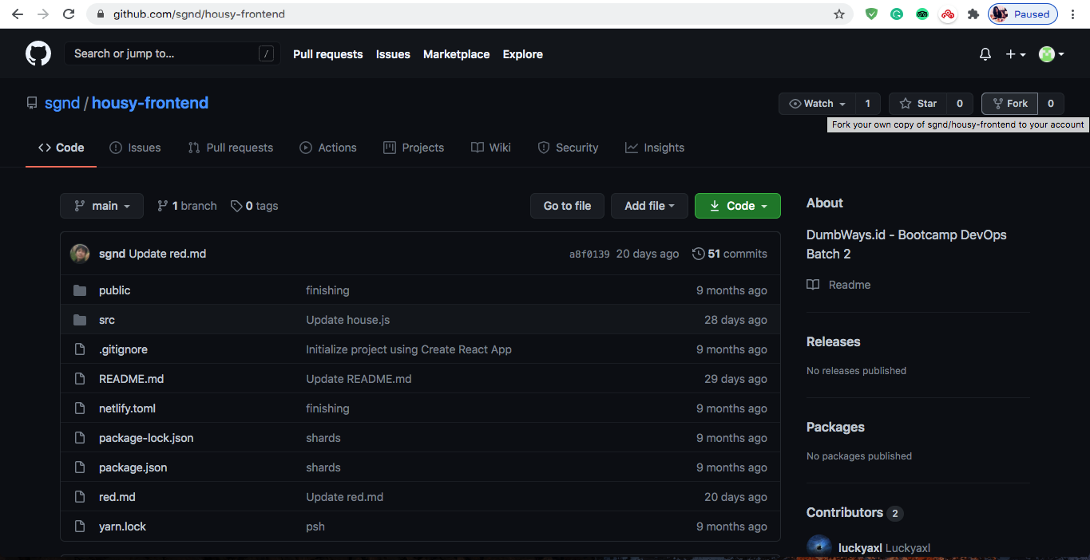
Repository Forking

Slide 6
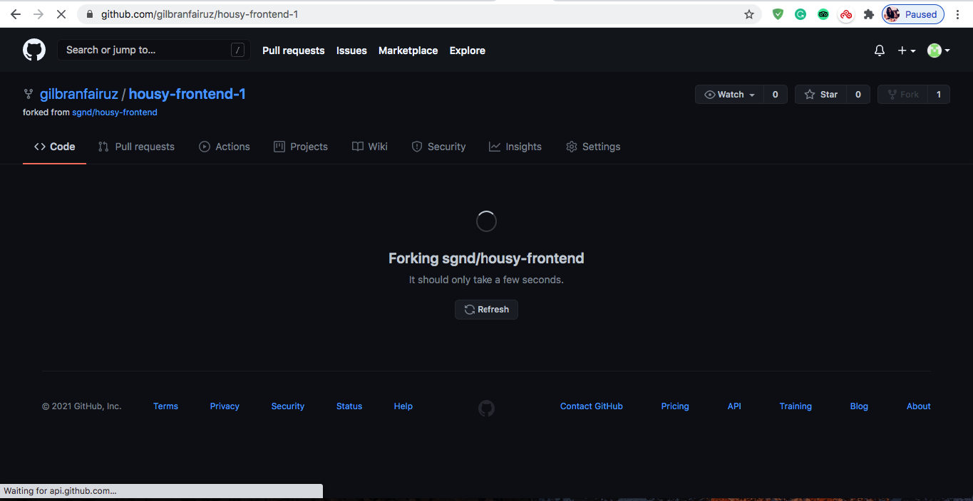
Repository Forking

Slide 7
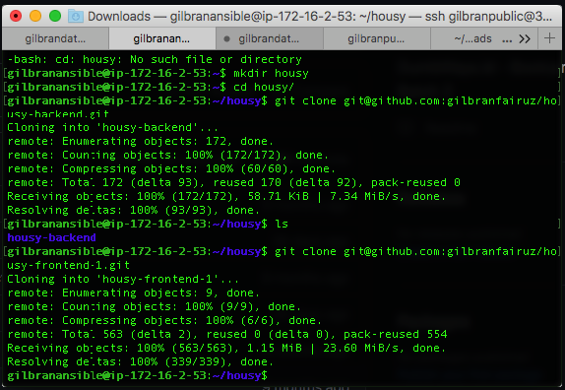
Repository Clone

Slide 8
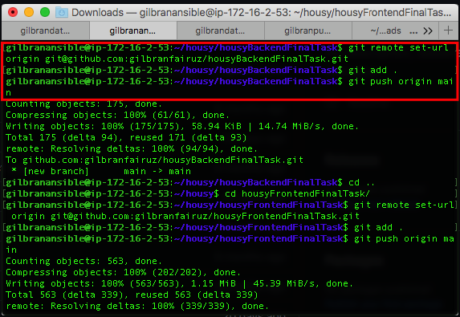
Repository set-url

Slide 9
Repository branch production dan development

Slide 10
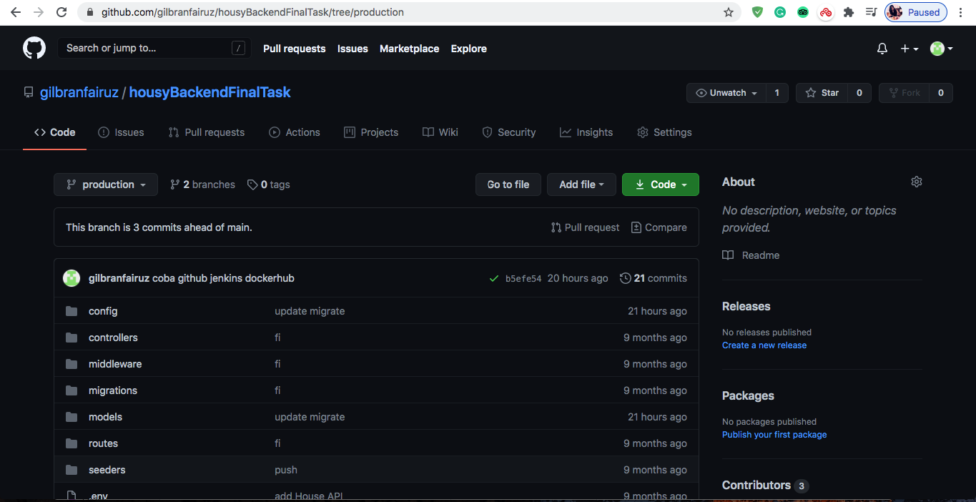
Repository Push

Slide 11
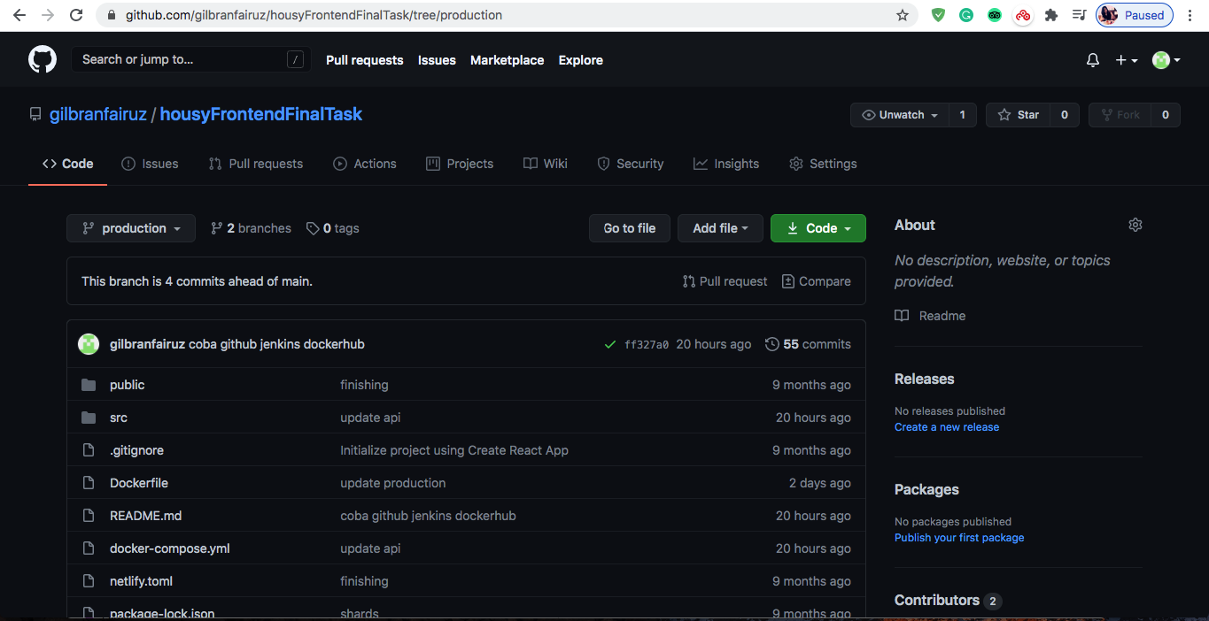
Repository Push

Slide 12
SERVER
VPC
NAT
Server

Slide 13
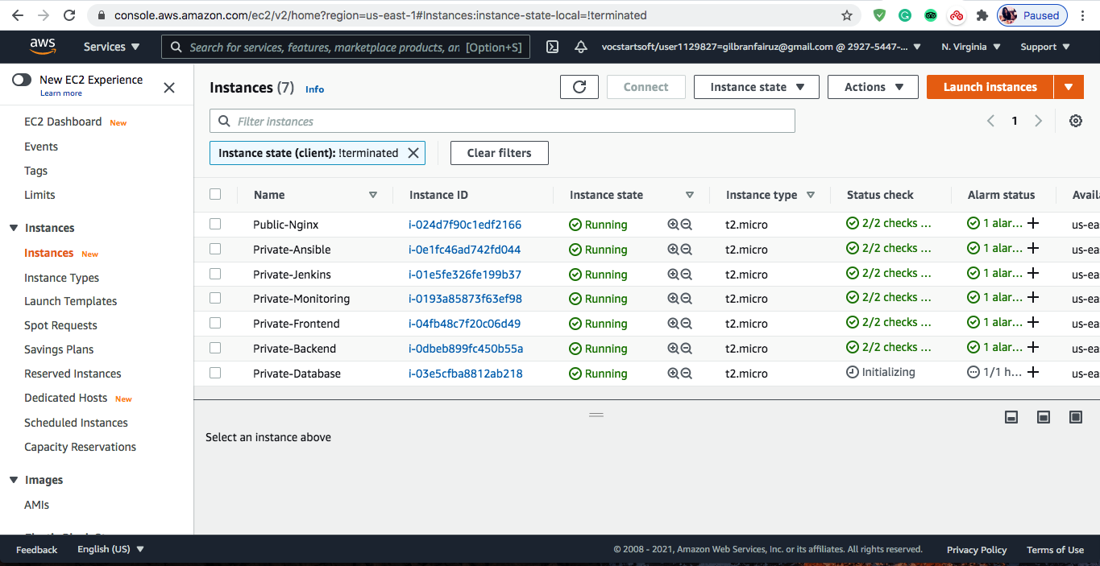
SERVER

Slide 14
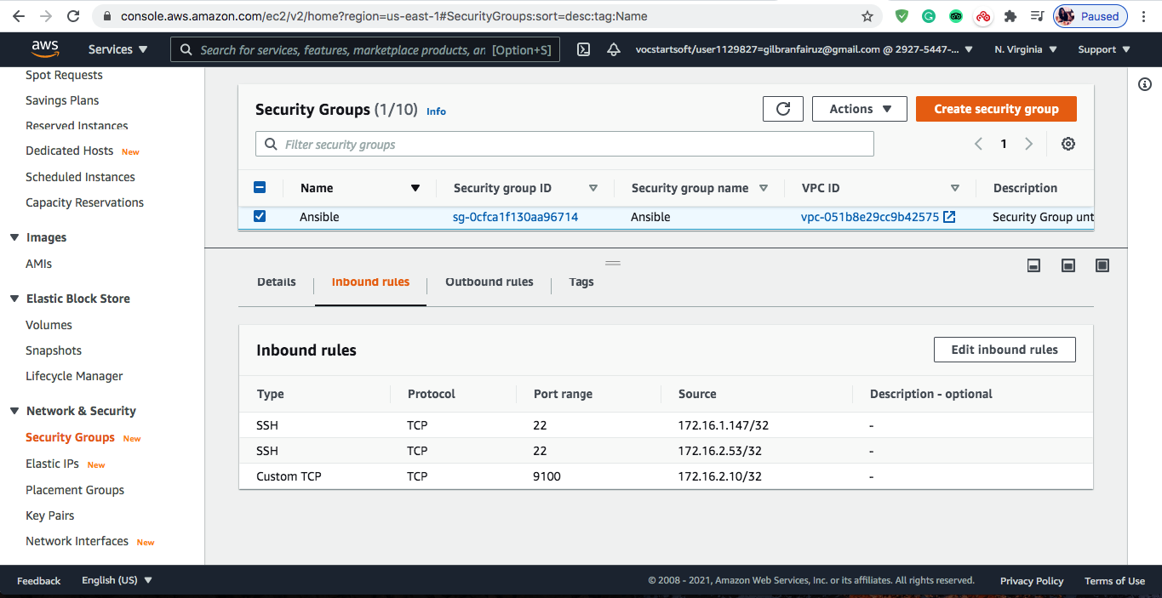
SERVER

Slide 15
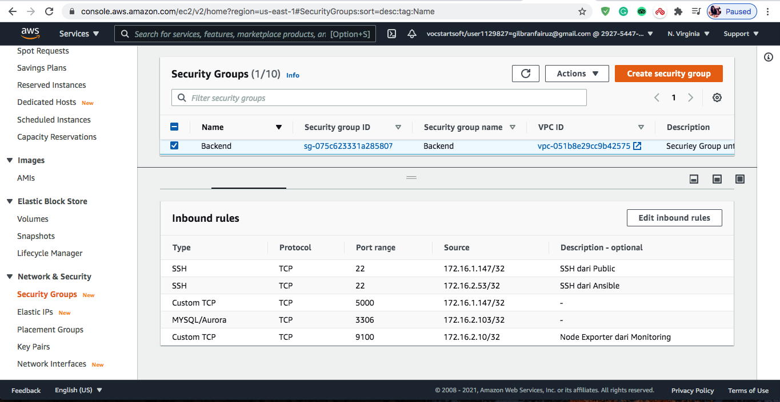
SERVER

Slide 16
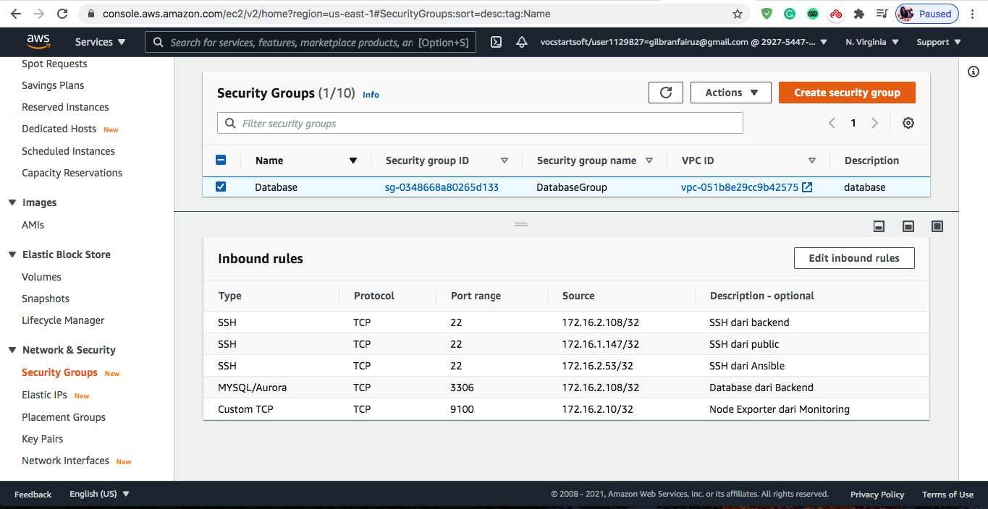
SERVER

Slide 17
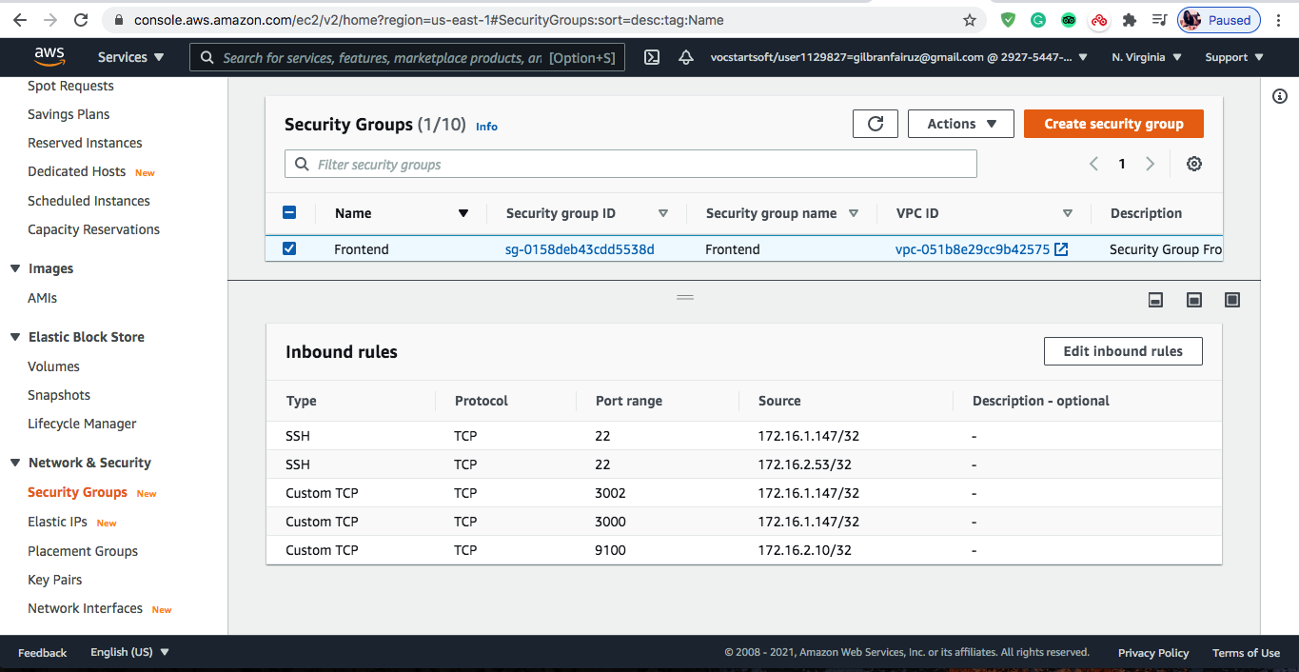
SERVER

Slide 18
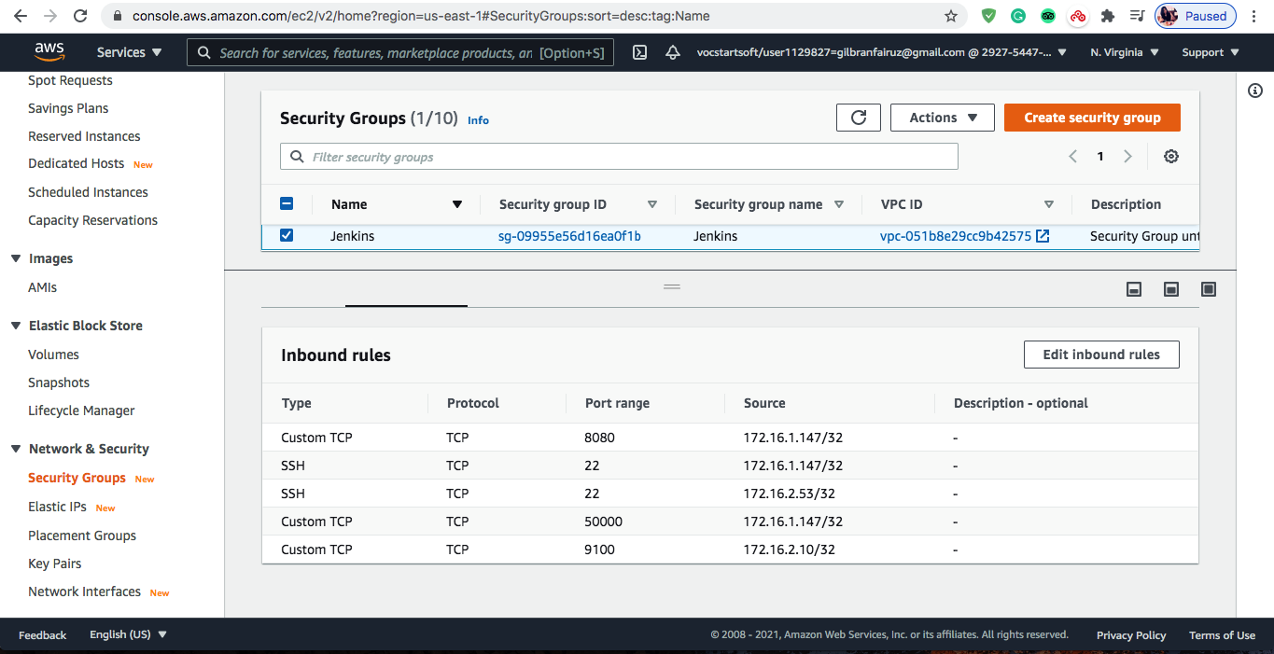
SERVER

Slide 19
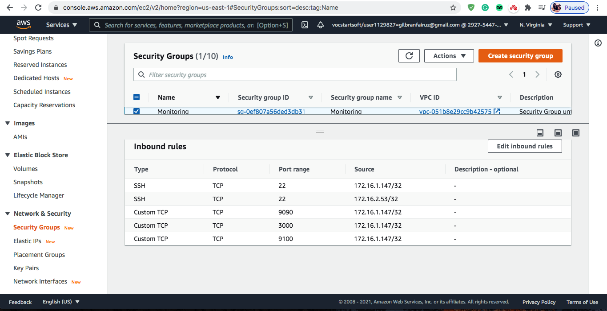
SERVER

Slide 20
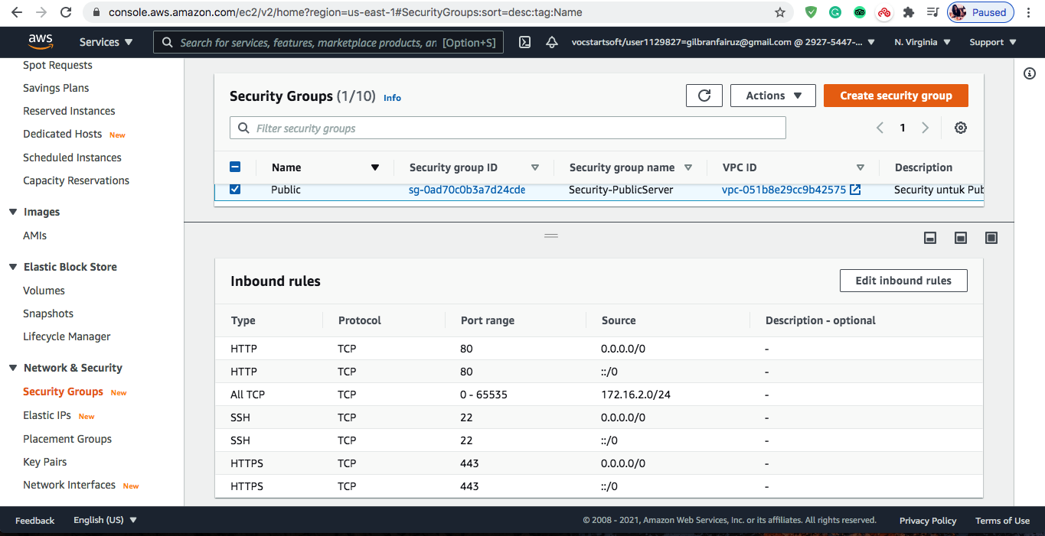
SERVER

Slide 21
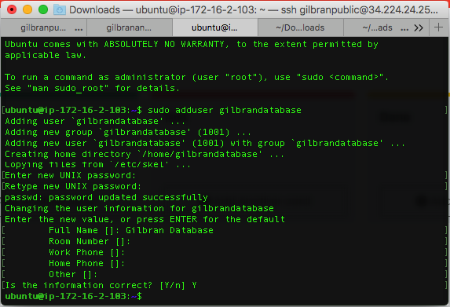
USER

Slide 22
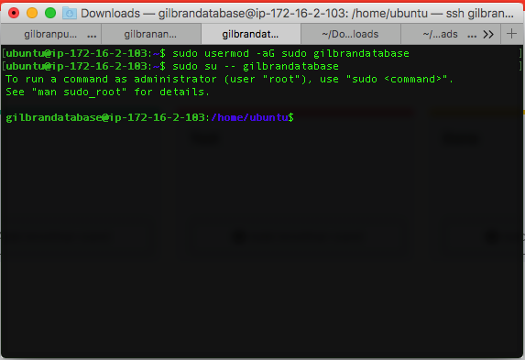
USER

Slide 23
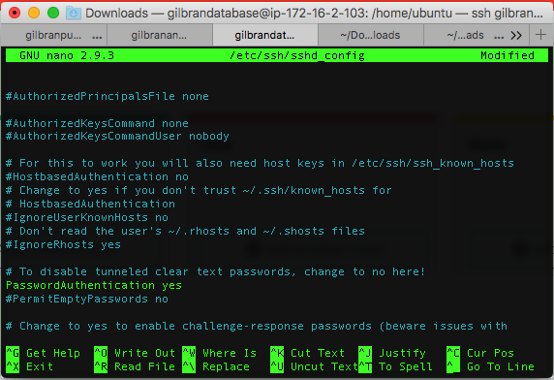
USER

Slide 24
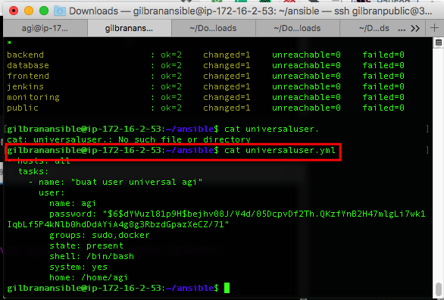
SSH

Slide 25
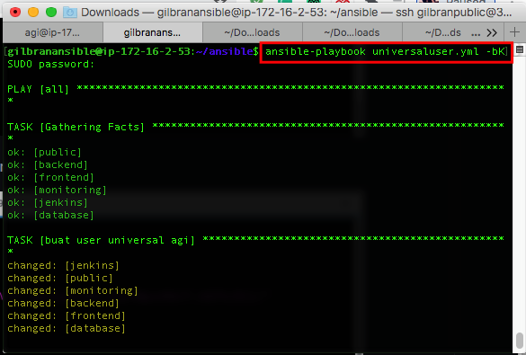
SSH

Slide 26
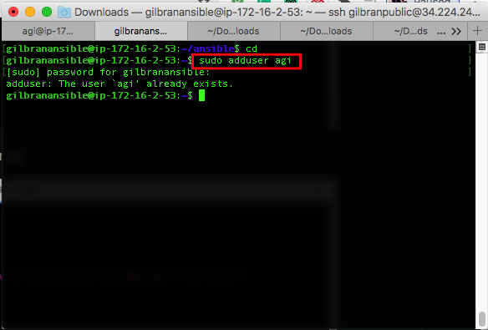
SSH

Slide 27
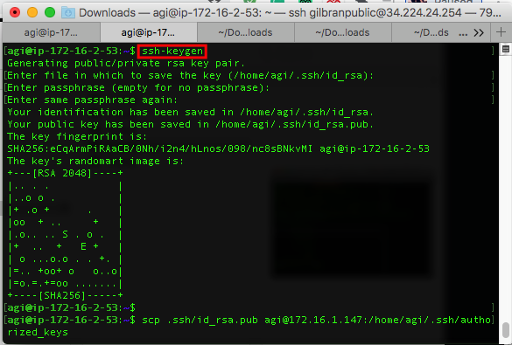
SSH

Slide 28
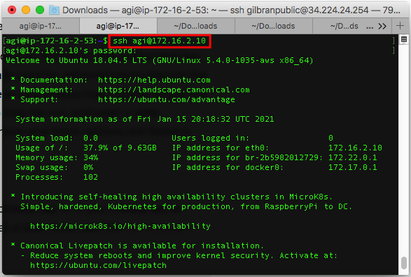
SSH

Slide 29
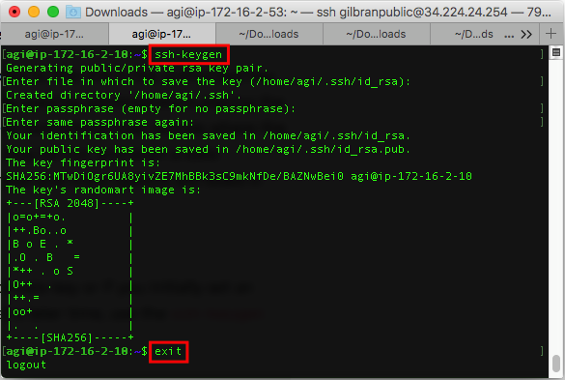
SSH

Slide 30
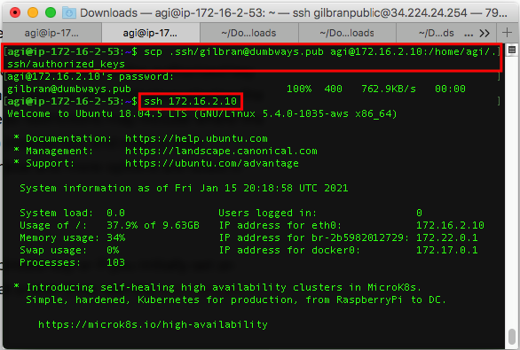
SSH

Slide 31
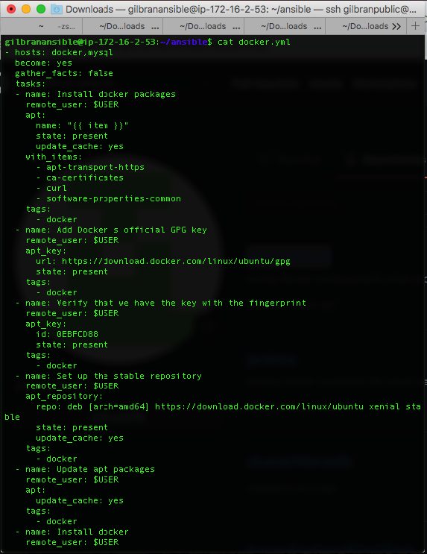
DATABASE

Slide 32
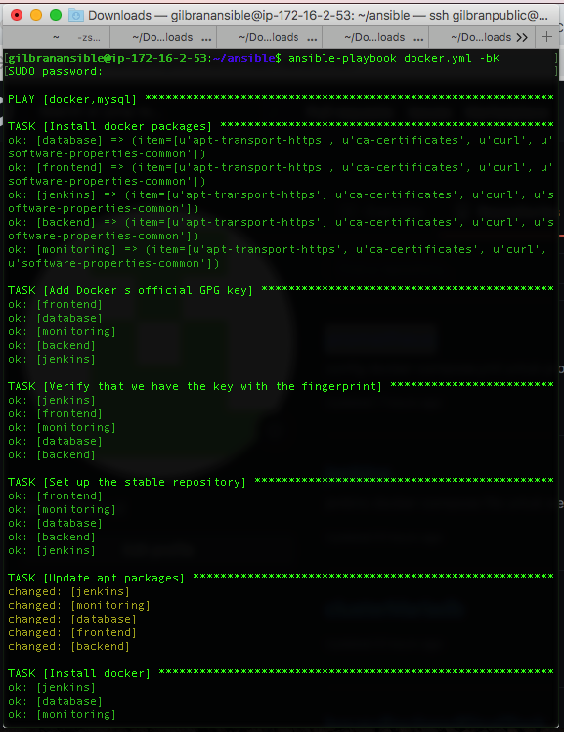
DATABASE

Slide 33
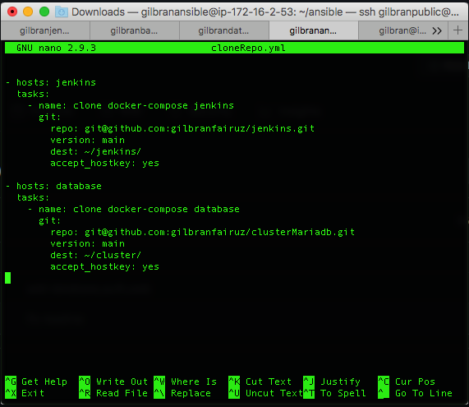
DATABASE

Slide 34
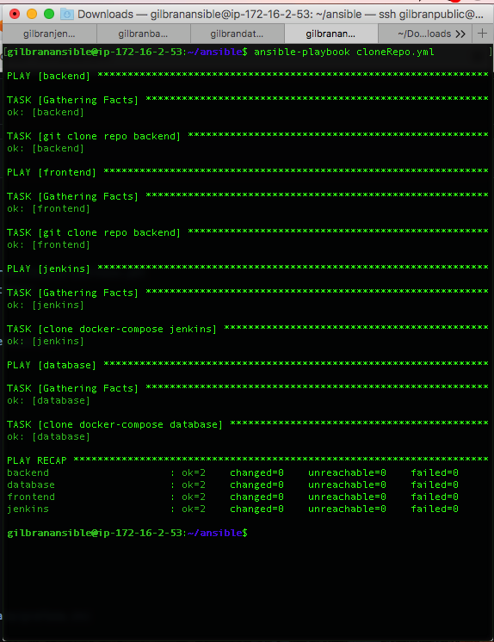
DATABASE

Slide 35
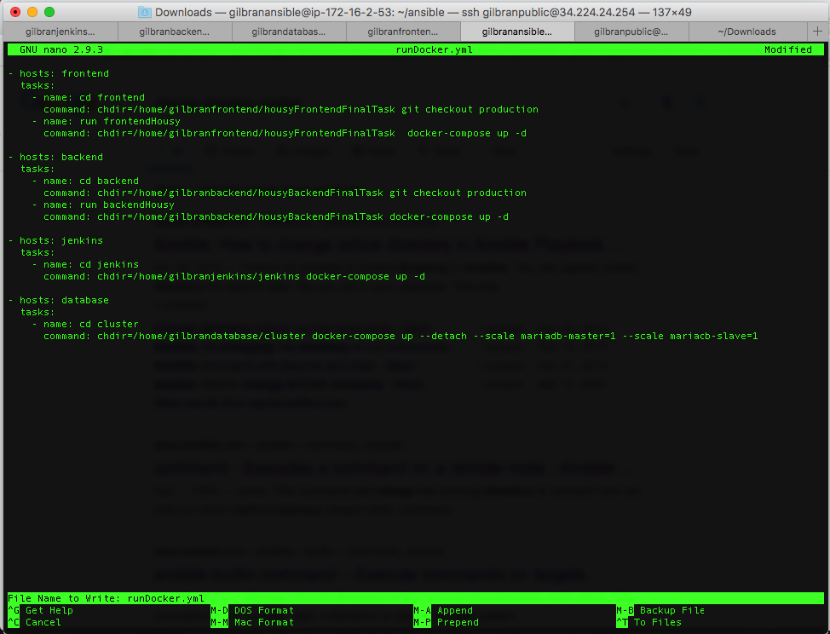
DATABASE

Slide 36
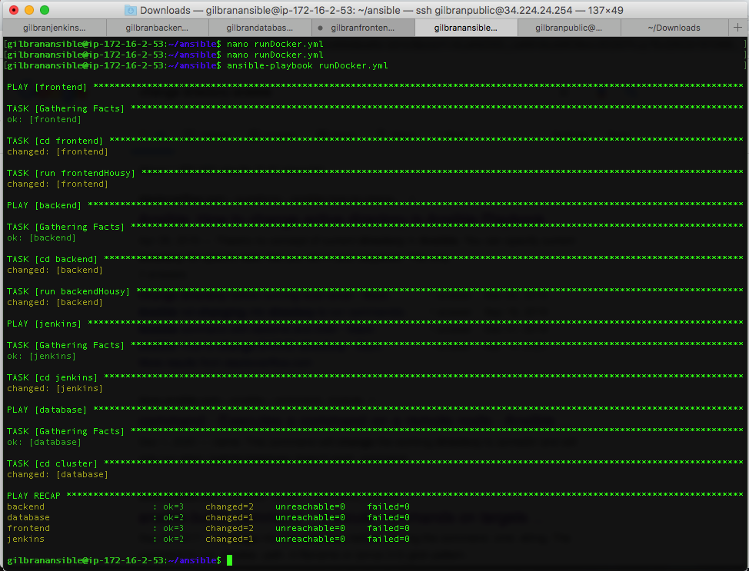
DATABASE

Slide 37
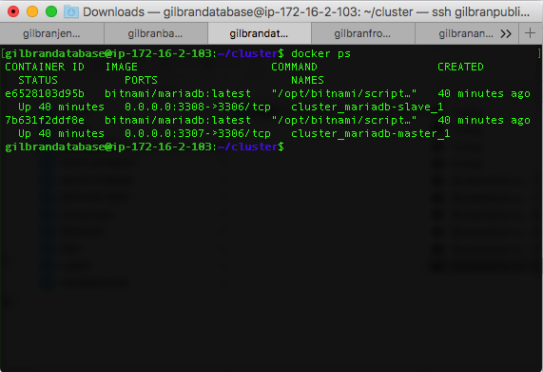
DATABASE

Slide 38
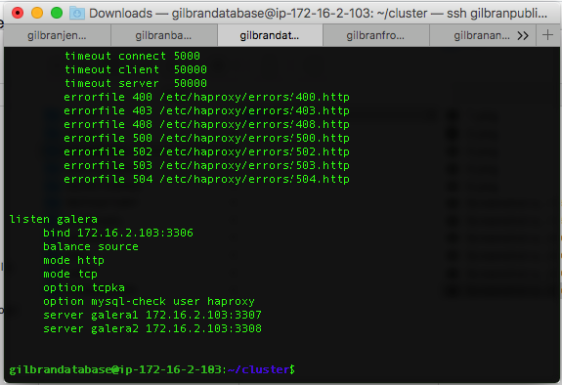
DATABASE

Slide 39
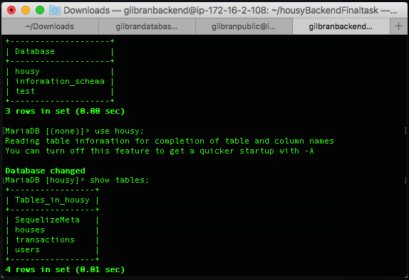
DATABASE

Slide 40
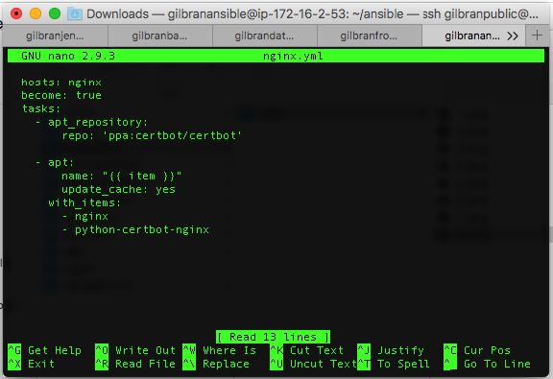
WEB SERVER

Slide 41
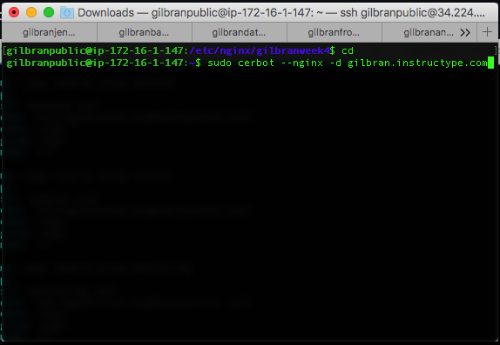
WEB SERVER

Slide 42
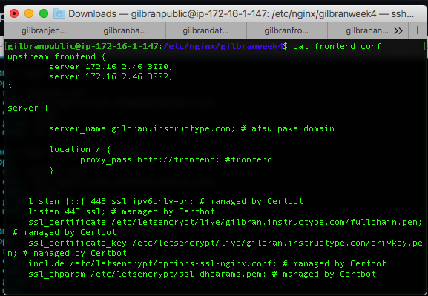
WEB SERVER

Slide 43
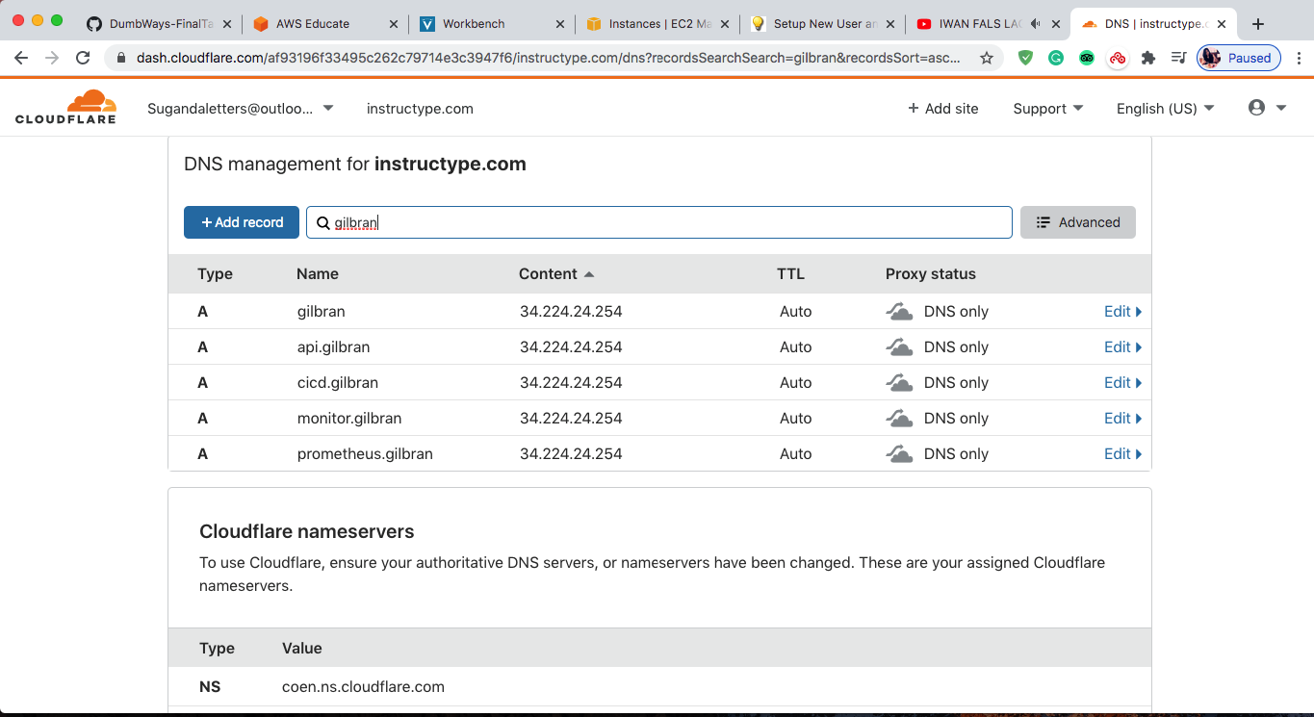
WEB SERVER

Slide 44
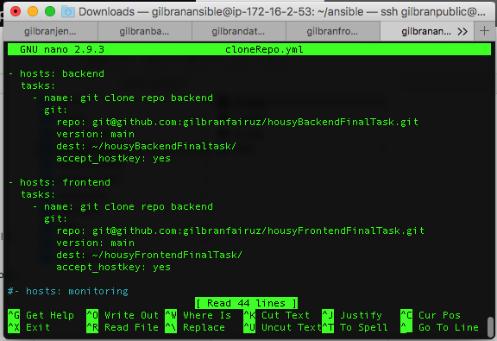
DEPLOYMENT

Slide 45
DEPLOYMENT

Slide 46
DEPLOYMENT

Slide 47
DEPLOYMENT

Slide 48
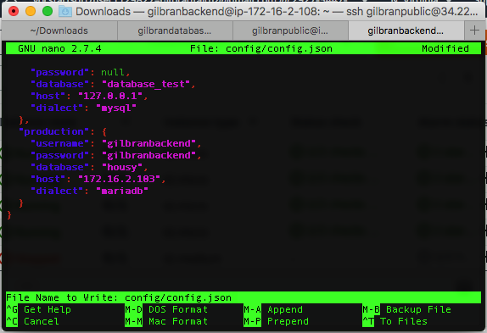
DEPLOYMENT

Slide 49
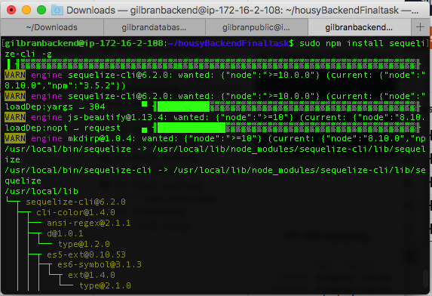
DEPLOYMENT

Slide 50
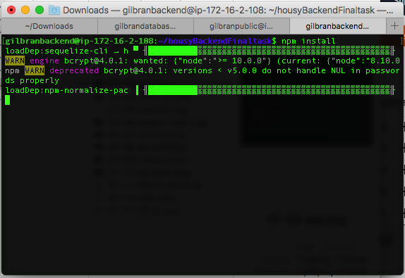
DEPLOYMENT

Slide 51
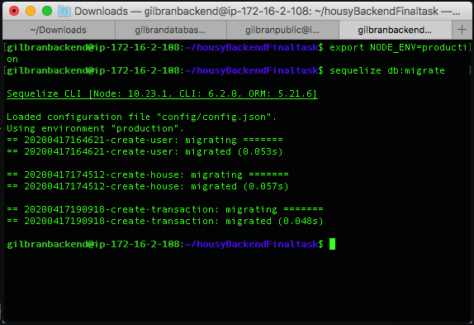
DEPLOYMENT

Slide 52
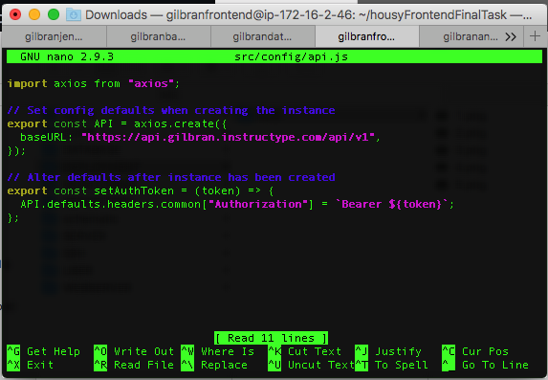
DEPLOYMENT

Slide 53
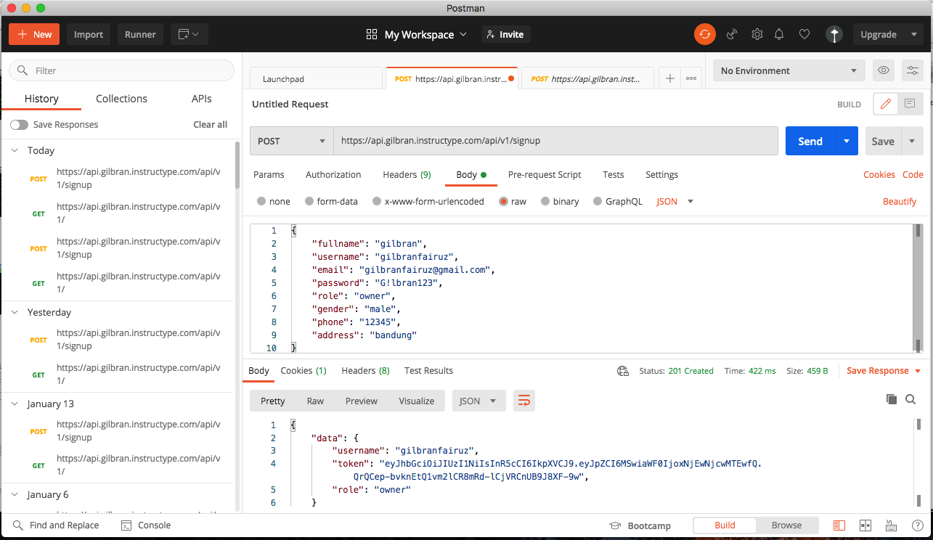
DEPLOYMENT

Slide 54
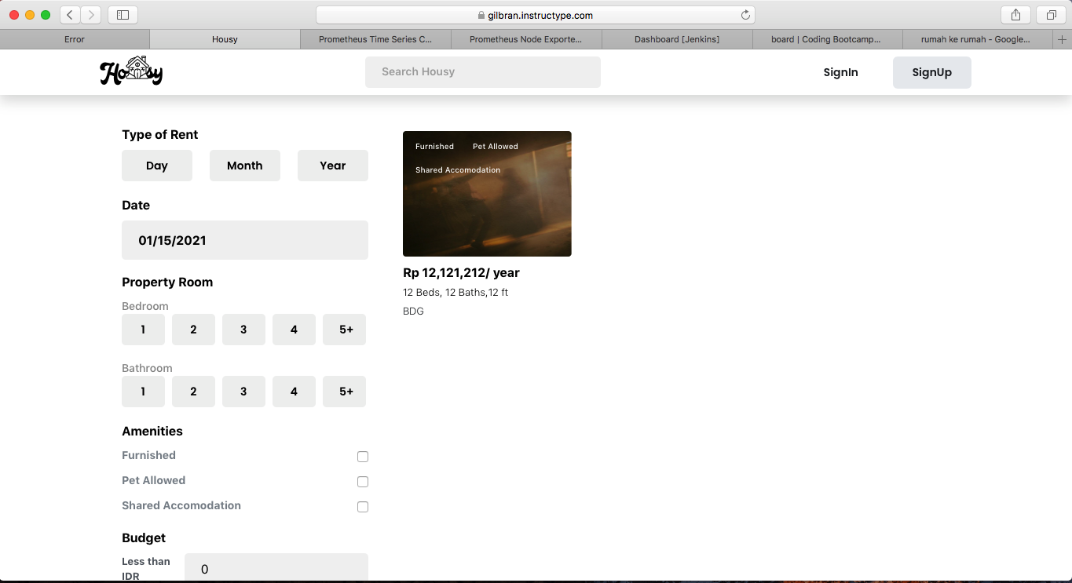
DEPLOYMENT

Slide 55
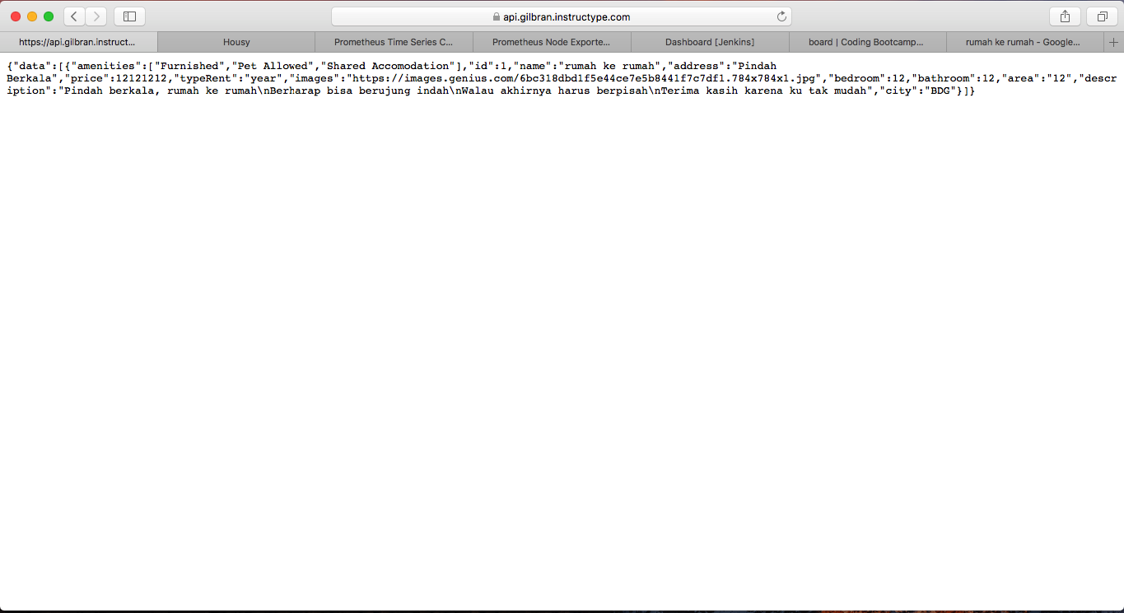
DEPLOYMENT

Slide 56
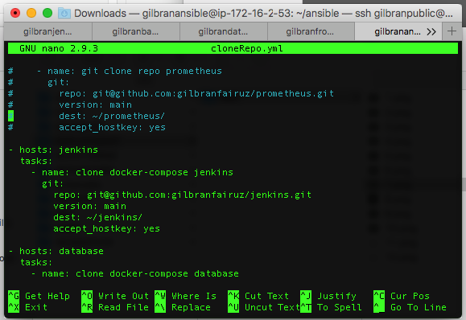
CI/CD

Slide 57
CI/CD

Slide 58
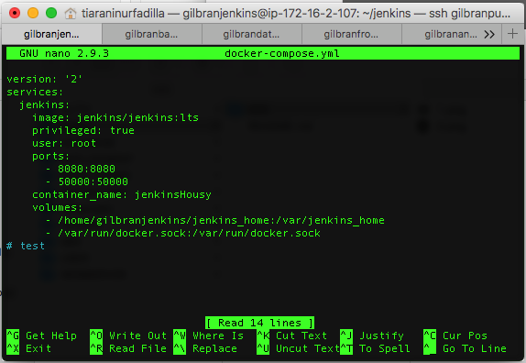
CI/CD

Slide 59

CI/CD

Slide 60

CI/CD

Slide 61

CI/CD

Slide 62

CI/CD

Slide 63

CI/CD

Slide 64

CI/CD

Slide 65

CI/CD

Slide 66

CI/CD

Slide 67

CI/CD

Slide 68

CI/CD

Slide 69

CI/CD

Slide 70

CI/CD

Slide 71

CI/CD

Slide 72

CI/CD

Slide 73

CI/CD

Slide 74

CI/CD

Slide 75

CI/CD

Slide 76

CI/CD

Slide 77

CI/CD

Slide 78

CI/CD

Slide 79

CI/CD

Slide 80

CI/CD

Slide 81

CI/CD

Slide 82

CI/CD

Slide 83

CI/CD

Slide 84

CI/CD

Slide 85

CI/CD

Slide 86

CI/CD

Slide 87

CI/CD

Slide 88

CI/CD

Slide 89

MONITORING

Slide 90

MONITORING

Slide 91

MONITORING

Slide 92

MONITORING

Slide 93

MONITORING

Slide 94

MONITORING

Slide 95

MONITORING

Slide 96

AUTHENTICATION

Slide 97

AUTHENTICATION

Slide 98

AUTHENTICATION

Slide 99

AUTHENTICATION

Slide 100
THANKS!

